Slide 1
New Approach to SCM (Supply Chain Management) using Blockchain.
Name:- Ayush Vedprakash Agarwal
Roll NO :- TCOA02
Mobile :- 7776075075
E-mail ID:- ayushbansal323@gmail.com
Area :- Blockchain

Slide 2
Content
Abstract
Introduction
Literature survey
Motivation
Blockchain solution
Proposed System
Flow of Proposed System
Technology stack
Advantages and Disadvantages
Applications

Slide 3
Abstract
Blockchain is a recently introduced concept . Initially popularized by Bitcoin , Blockchain is more than the foundation of cryptocurrency . It offers a secure way to exchange any kind of good, services or transaction .It felicitates smart contract, engagements and agreements with inherent , robustness .

Slide 4
Introduction
Wikipedia defines Blockchain as “A decentralized and distributed digital ledger that is used to record transactions across many computers so that the record cannot be altered retroactively without the alteration of all subsequent blocks and the collusion of the network.”

Slide 5
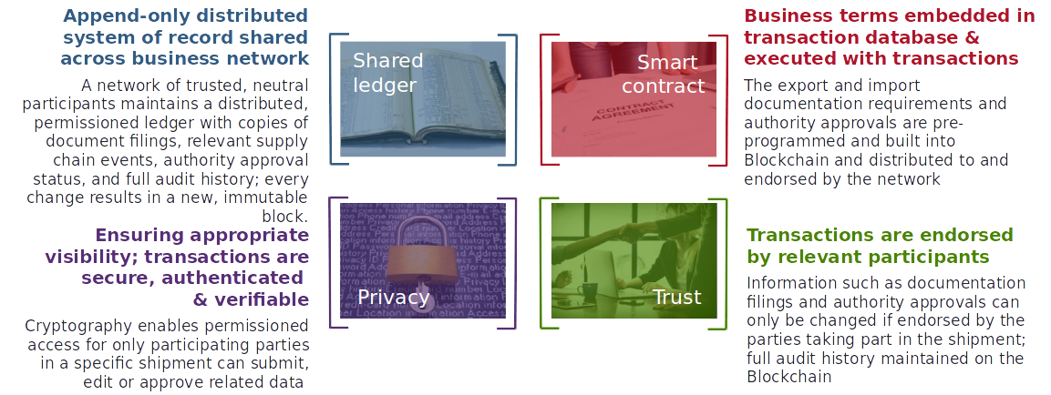
Introduction

Slide 6
Introduction
Supply chain management (SCM) is the active management of supply chain activities to maximize customer value and achieve a sustainable competitive advantage SCM involves a series of key activities and processes that must be completed in an efficient and timely manner. Otherwise, product will not be
available when needed by consumers.

Slide 7
Introduction
The Early Years
In the 1940s and 1950s, the focus of logistics research was on how to use mechanization to improve the very labor intensive processes of material handling and how to take better advantage of space using racking.
The Technology
Revolution
The logistics boom was fueled further in the 1990s by the emergence of Enterprise Resource Planning (ERP) systems, result of this change to ERP systems was a tremendous improvement in data to gain a competitive edge.
Logistics Comes of
Age
Early 1980s provided tremendously better computer access to planners and a new graphical environment for planning. Company executives became aware of logistics as an area where they had the opportunity to significantly improve the bottom line

Slide 8
Introduction
Globalization and Supply
Chains
Recognition of the term "supply chain" has come primarily as a result of the globalization of manufacturing This growing association of supply chain management with strategy is reflected in the Council of Logistics Management's changing
Future
Mathematical algorithms will automate Supply Chain planning processes and accelerate the decision-making The technology and analytics will fuel algorithmic business, that means hiring data scientists and investing in advanced business intelligence tools is must.
Now
Today Supply Chain Management is expanding its domain and also includes services such as:
• Operational Analysis and Design Materials Handling
• Distribution Strategy
• Warehouse Design Project Management

Slide 9
Literature Survey
Sr No. | Name Of Author | Paper | Year | Applications | Reference Links
1 | S. Nakamoto | Bitcoin: A Peer-to-Peer Electronic Cash System, | Oct,2008. | cryptocurrency | https://bitcoin.org/bitcoin.pdf
2 | IBM | THE SMARTER SUPPLY CHAIN OF THE FUTURE | 2017 | Trace drug in every stage of supply chain | https://www-03.ibm.com/
3 | Aziz Muysinaliyev, Sherzod Aktamov | Supply chain management concepts: literature review | Jan. 2014 | SCM | http://www.iosrjournals.org/iosr-jbm/papers/Vol15-issue6/I01566066.pdf

Slide 10
Literature Survey
Sr No. | Name Of Author | Paper | Year | Applications | Reference Links
4 | Mayra Samaniego , Ralph Deters | Blockchain Based Framework For Data Sharing | Dec. 2016 | IOT | https://ieeexplore.ieee.org/document/7917130
5 | SHANGPING .W YINGLONG .Z, YALING ZHANG | Blockchain Framework For Data Sharing | 2018 | Secure Data Transfer | https://ieeexplore.ieee.org/document/8292361
6 | Stefan Hickmott, Chad Fernandez, Alex Norta | Commercial Property Tokenizing With Smart Contracts | 2018 | Real-Estate Market | https://ieeexplore.ieee.org/document/8489534

Slide 11
Motivation
• • Margin erosion and sudden demand changes: Rapidly changing environments requires businesses to quickly react to sudden demand changes on an increasing frequency. With globalization
came fiercer competition that put pressure on margins.
• • Ripple effect due to extended value chain: Due to extensive supply chains, companies are facing significant variability risks. Several layers of stakeholders, including suppliers, distributors, and customers, significantly increase the supply chain risk.
• • Ineffective supply chain risk management: Building effective supply chain risk management programs are key to accurately monitor and predict risk in order to react properly.
• • Lack of end-to-end visibility: Companies are struggling to have a clear overview on their supply chains—both internally and externally. This exposes them to different kinds of risks such as
fraud, code of conduct violations, andmore.
• • Obsolescence of technologies: Advanced supply chain management tools require significant and continuous investment. This also goes with inherent implementation risks that pose a major
challenge for most businesses.

Slide 12
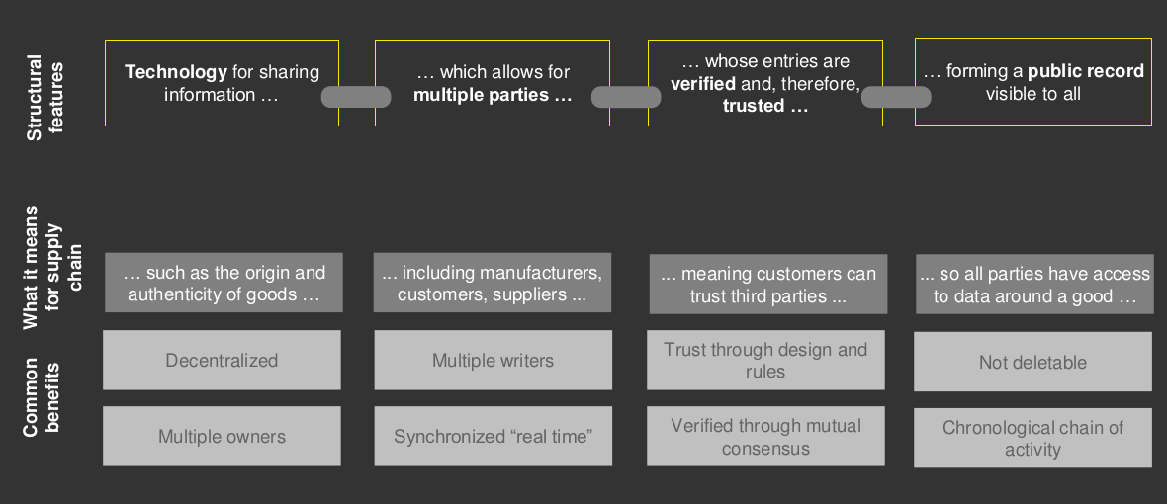
Blockchain solution

Slide 13
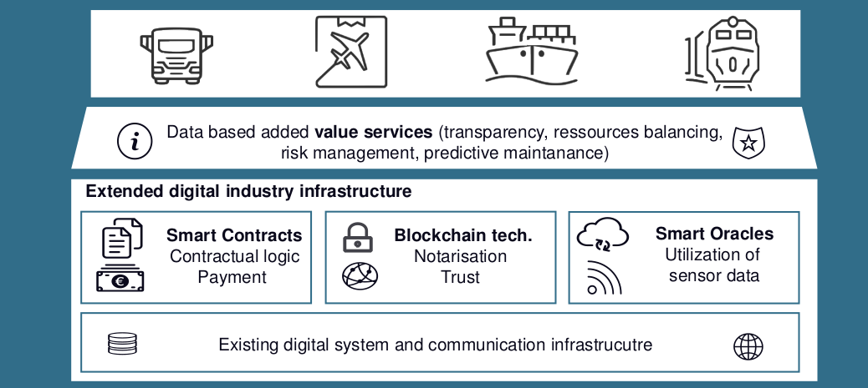
Proposed system

Slide 14
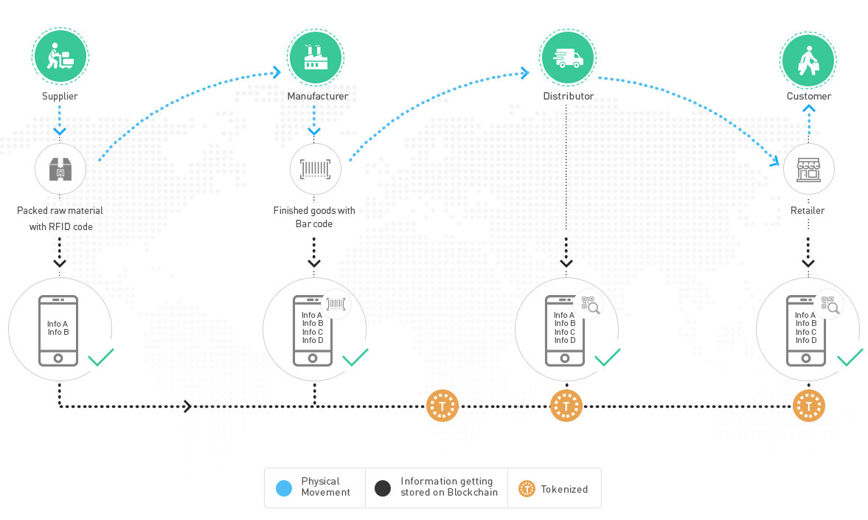
Flow of proposed system

Slide 15
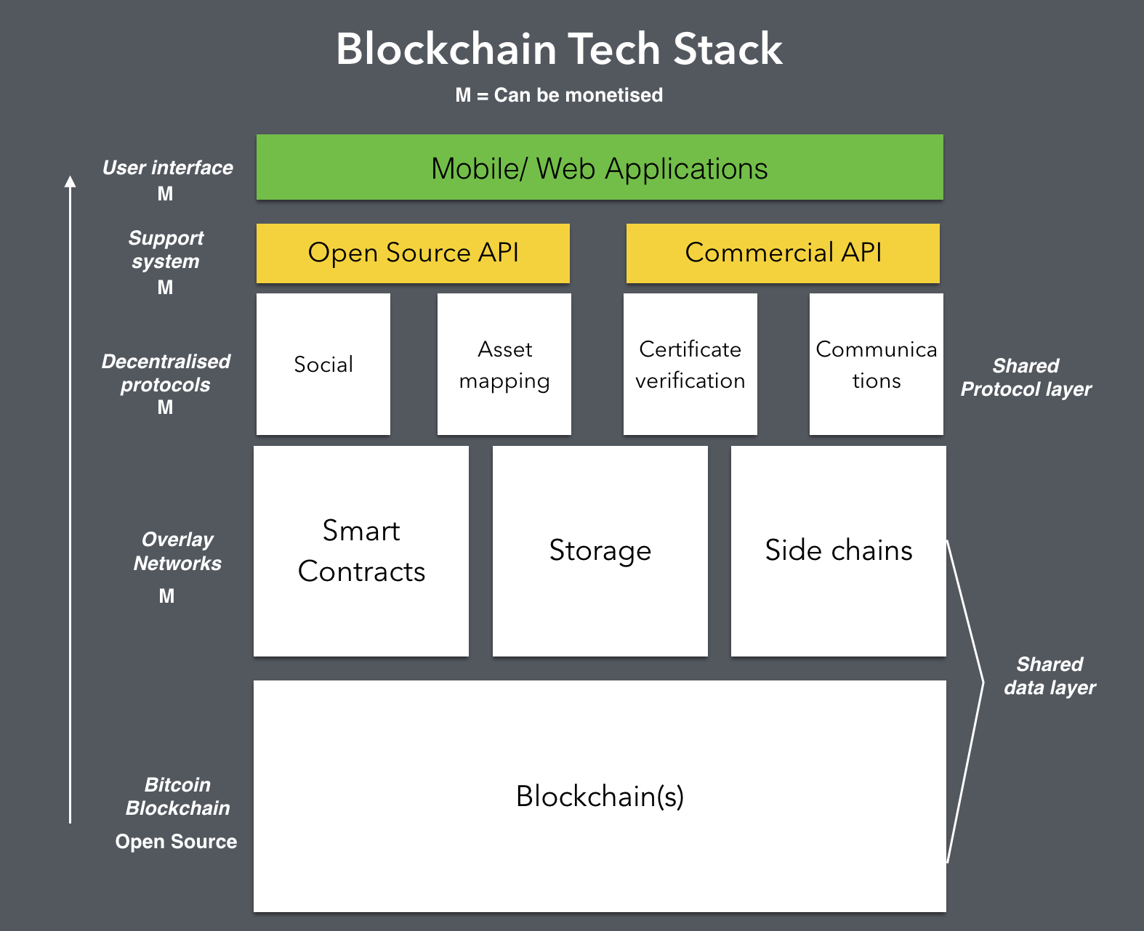
Technology stack

Slide 16
Advantages
1. Automating the purchase process
2. Improving transaction flow
3. Securing the supply chain
4. Ensuring integral traceability
5. Being more reactive
6. Streamlining internal documents

Slide 17
Disadvantages
Ecosystem still in progress
Technology and knowhow
Initial Costs
Awareness and understanding

Slide 18
Applications
Supply chain product certification
blockchain-powered, industrial Internet of Things
tracking and traceability of goods
supply chain smart contracts
Chain of shipping

Slide 19
THANK YOU

